Slide 1

SSID: WWCode
Password: password
Notes:
Please remove this slide when sharing the document to the public

Slide 2
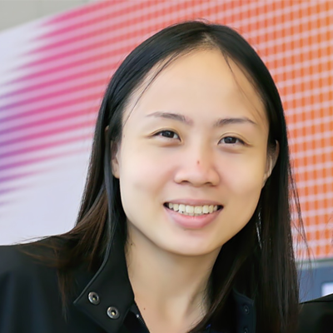

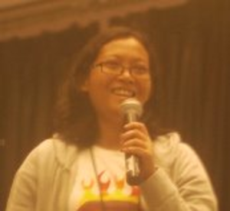
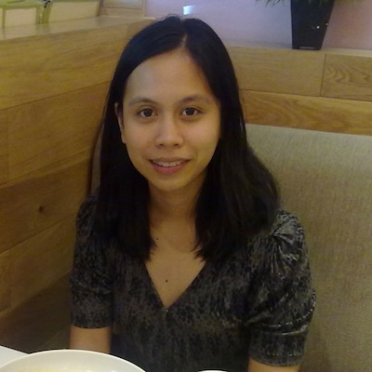
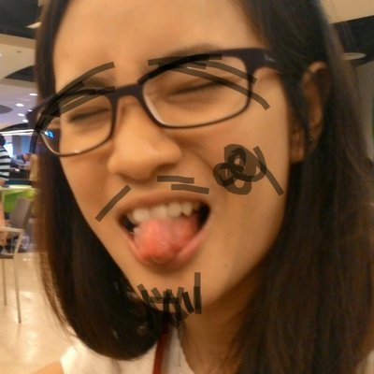
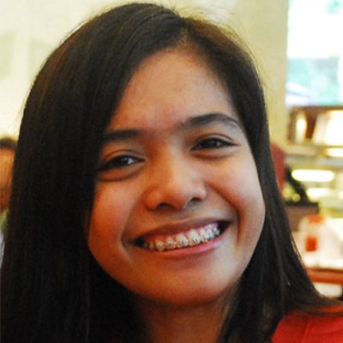

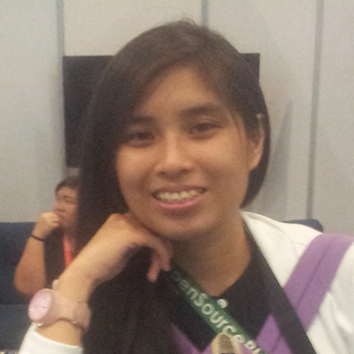
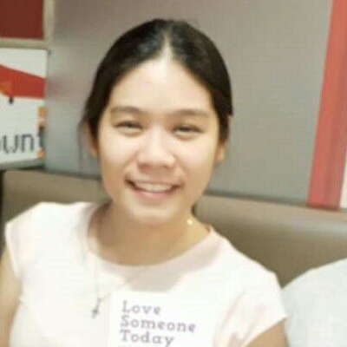
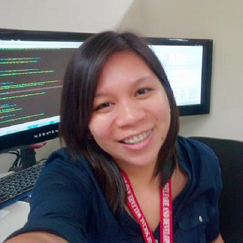
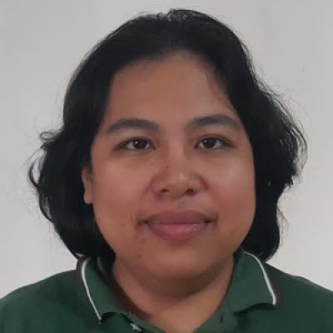
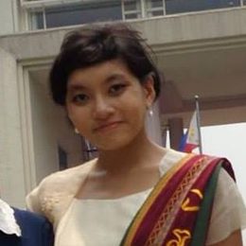
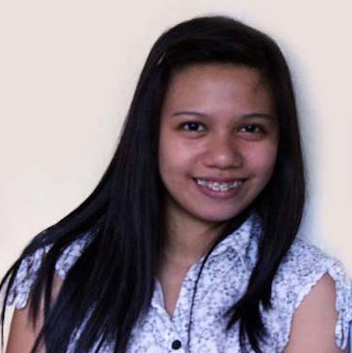
iOS STUDY GROUP
Twitter: @wwcodemanila
FB: fb.com/wwcodemanila
#WWCodeManila
#iOS #Swift
#StudyGroup

Slide 3
Ciela Salazar
iOS Developer
Sprim
Notes:
Please use only the three colors for the content.

Slide 4
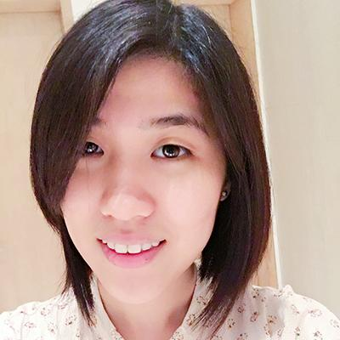
Steffi
iOS Developer
Deal Grocer
Notes:
Please use only the three colors for the content.

Slide 5
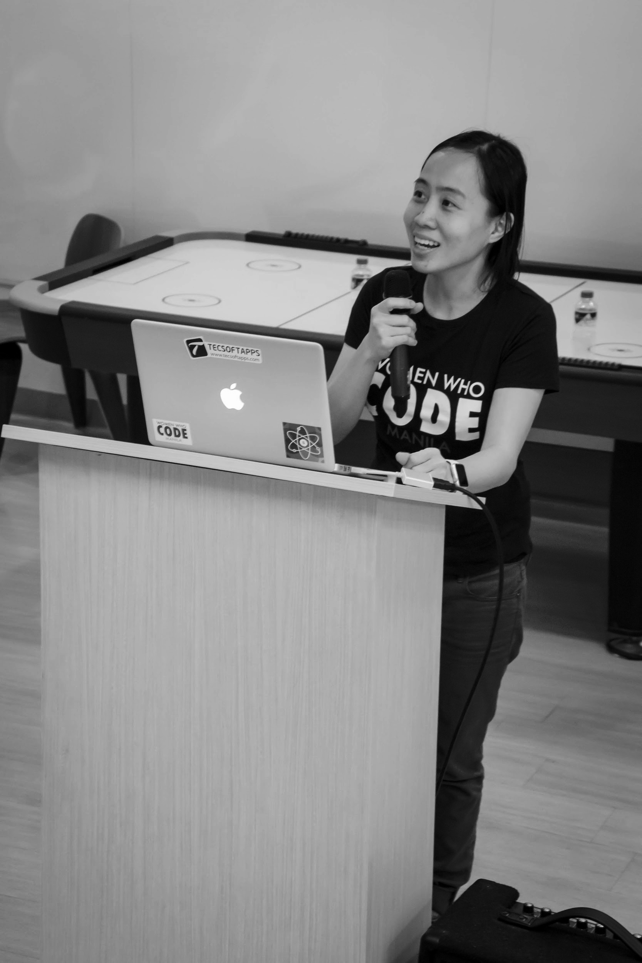

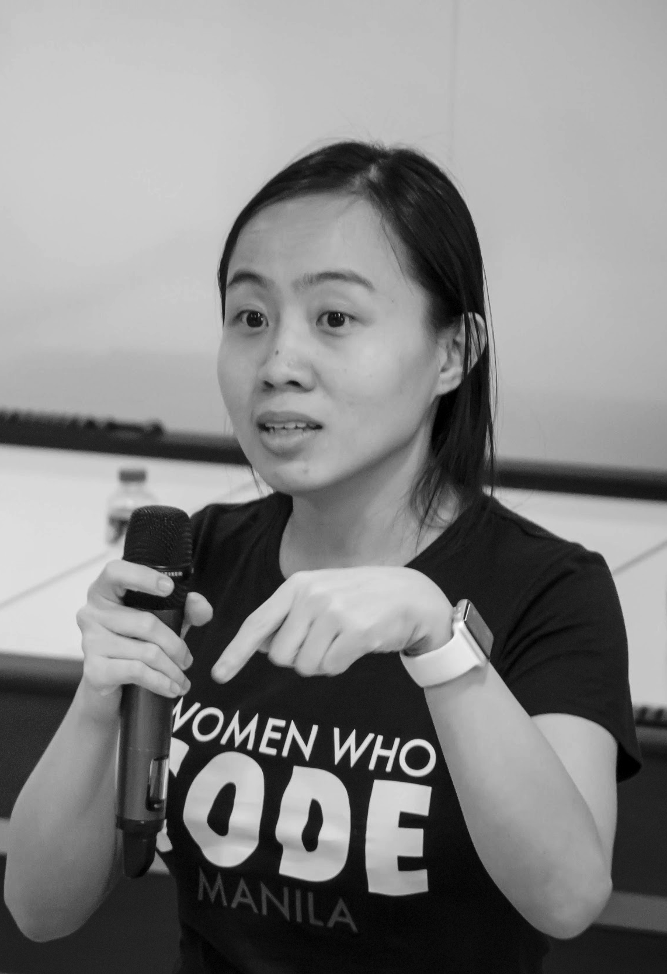
OUR MISSION
Inspiring women to excel in technology careers.

Slide 6
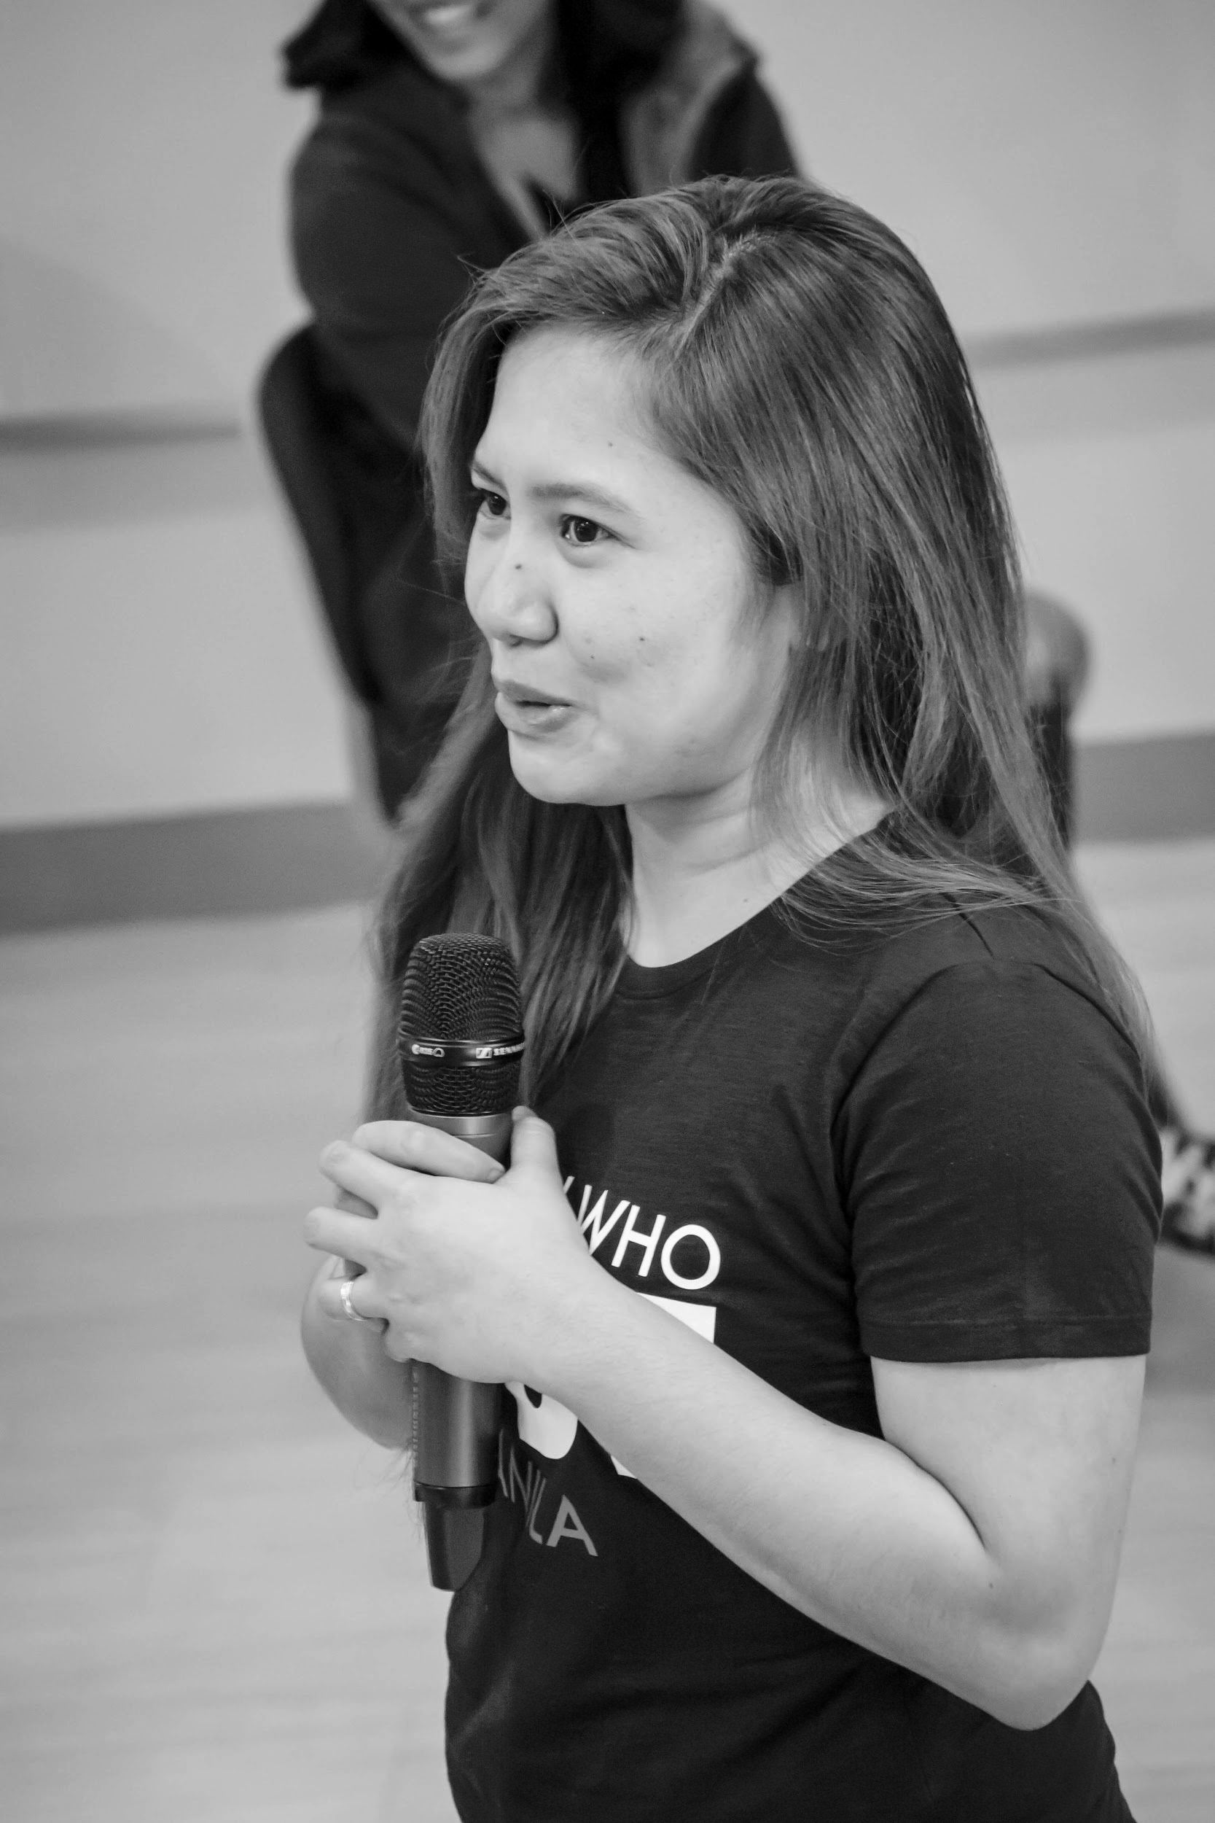
OUR VISION
A world where women are representative as technical executives, founders, VCs, board members and software engineers.

Slide 7
STUDY GROUP
Study groups are events where women can come together and help each other learn and understand a specific programming language, technology, or anything related to coding or engineering.

Slide 8
GUIDELINES
If you have a question, just ask
If you have an idea, share it
Make friends and learn from your study groupmates
Do not recruit or promote your business

Slide 9
New Member’s Introduction

Slide 10
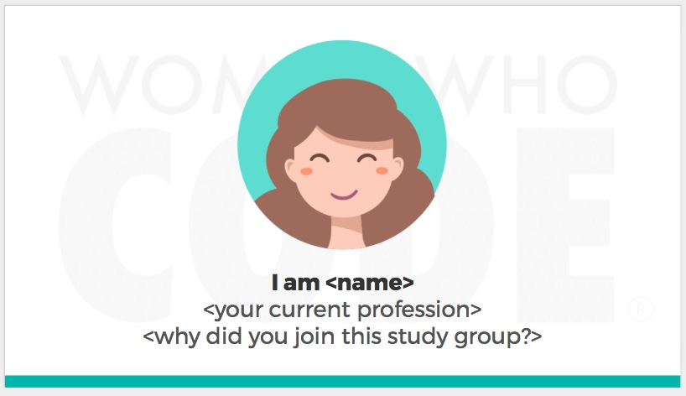
Notes:
Please use only the three colors for the content.

Slide 11
SHOW & TELL
Notes:
Please use only the three colors for the content.

Slide 12
TOPIC FOR TODAY
Notes:
Please use only the three colors for the content.

Slide 13
AUTOLAYOUT AND CONSTRAINTS
(OUR FIRST REFACTORING 🍕)
Notes:
Please use only the three colors for the content.

Slide 14
Code Refactoring: What is it?
- the process of restructuring existing computer code without changing its external behavior (Wikipedia.org)
Advantages of Code Refactoring:
Code Readability
Reduced Complexity
Improve Source-Code Maintainability
Improve Extensibility – extend system and functionality

Slide 15
Let’s Define Autolayout
allows developers to create an adaptive UI that responds appropriately to changes in screen size and device orientation (AppCoda.com)
dynamically calculates the size and position of all the views in your view hierarchy, based on constraints placed on those views (Apple Documentation)
Note: Without autolayout, your app will look unfurnished and unadaptable to different iPhone models, and you don’t want that!!!

Slide 16
Autolayout has Attributes!

Slide 17
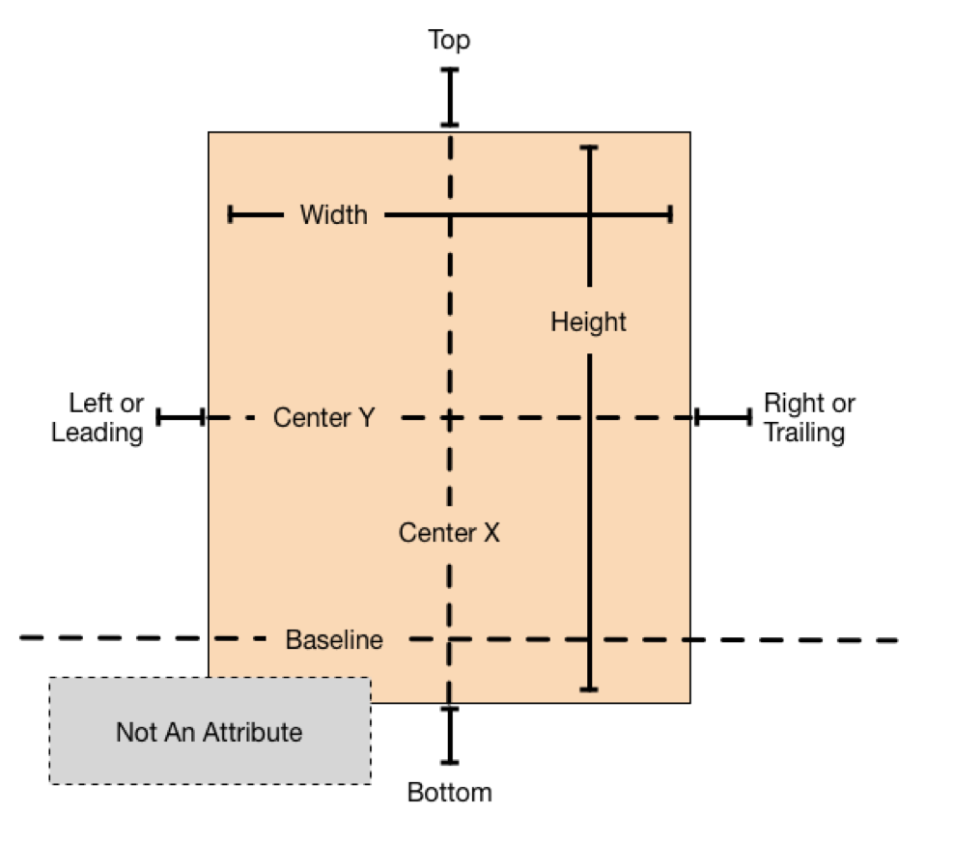

Slide 18
Let’s Define Constraints
The layout of your view hierarchy is defined as a series of linear equations. Each constraint represents a single equation. Your goal is to declare a series of equations that has one and only one possible solution. (Apple Documentation)

Slide 19
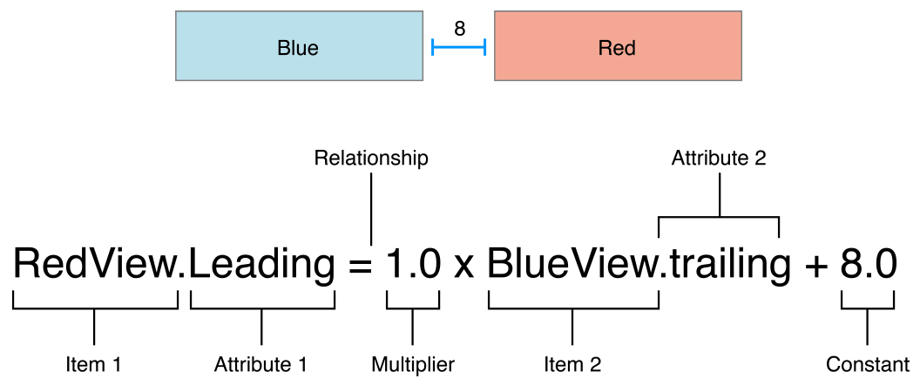

Slide 20
Partner/Group/Individual Exercise
Notes:
Please use only the three colors for the content.

Slide 21
Play with Autolayout!!!
- Add additional images, labels, text fields or buttons on the app screen and use autolayout to align these
- Present in front with different iPhone simulator devices
- Trial and Error is Key!

Slide 22
Partner/Group/Individual Presentation
Notes:
Please use only the three colors for the content.

Slide 23
Assignment
Notes:
No required

Slide 24
Did you know?
- You can use Stackview to easily layout UI elements
- You can write Constraints in code
- You can use Multiplier and Relationship in Constraints to your advantage
- You can use Constraints as Placeholders (meaning these will be gone as soon as app runs)
- You can set Content Hugging Priority and Compression Resistance Priority to UI Elements to control its stretching and shrinking abilities
- It takes practice and patience, don’t give up!

Slide 25
References
Notes:
Please use only the three colors for the content.

Slide 26
- Apple documentation (https://developer.apple.com)
- We Heart Swift
(https://www.weheartswift.com/auto-layout-101/)
- AppCoda
(https://www.appcoda.com/auto-layout-guide/)

Slide 27
T.I.L.
SHARE IT!
In front!
On Twitter: @wwcodemanila
Or FB: fb.com/wwcodemanila
Don’t forget to tag WWCodeManila so we can retweet or share it.
Notes:
Please use only the three colors for the content.

Slide 28
Feedback Form
https://goo.gl/YzSqcS
Please don’t rate the event on meetup.
Not helpful. It is best to just tell your concerns via the feedback form. We are a building a community not a Yelp restaurant.
Notes:
Please use only the three colors for the content.

Slide 29
THANK YOU :)
Notes:
Please use only the three colors for the content.

